Slide 1
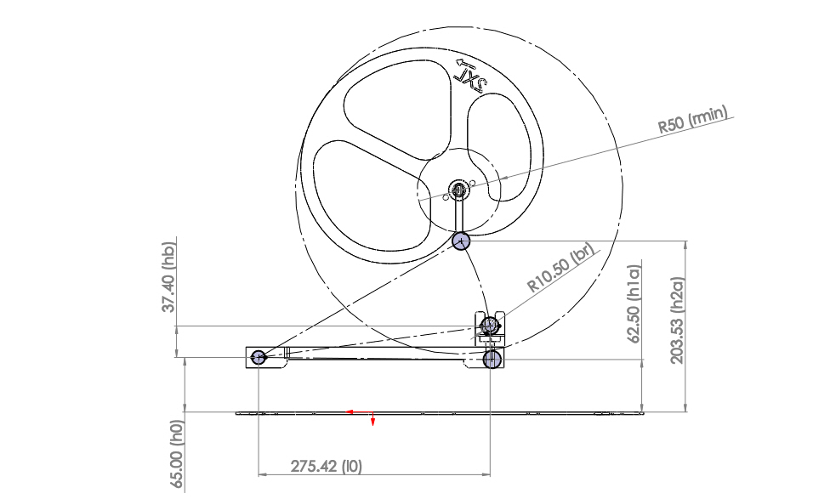
GEOMETRICAL PARAMETERS
l0 # Length from the bearing to the hinge
h0 # Length of the vertical wall which supports the hinge
Hb # Length of the vertical support of the bearing
br # Bearing radius
h2a | h1a # max and min positions of the bearing
rmin # Minimum radius of the camshaft

Slide 2
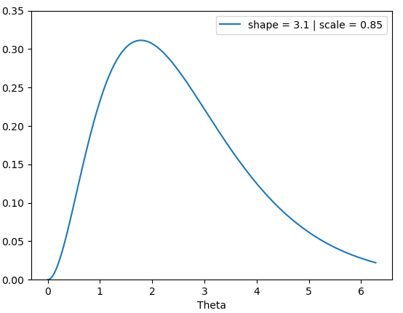
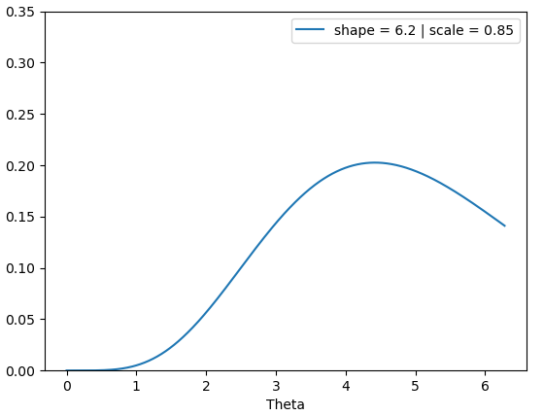
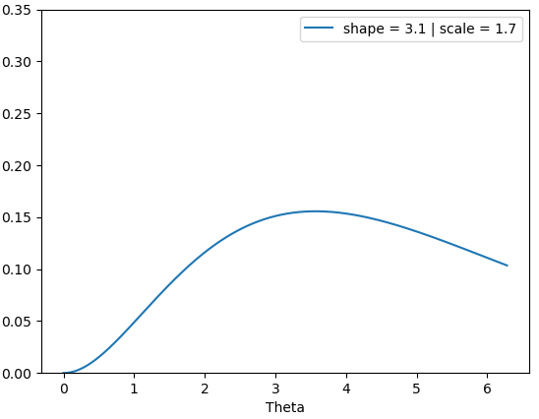
Gamma distribution – Shape and scale parameters
OBS: The exponential distribution is a special case of the gamma distribution, where the parameters shape and scale are equal to 1.

